Slide 1
A Metapopulation - Extinction Colonization Model
THEE Research Practical 2024
Emma Ochsner and Lena Witschi

Slide 2
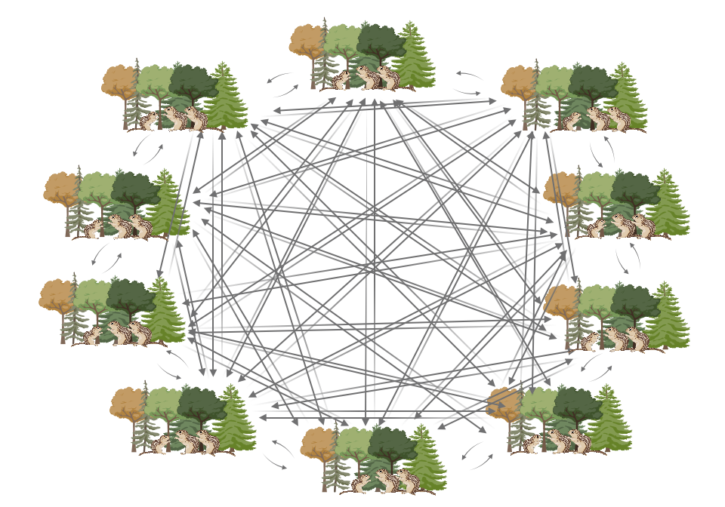
BIOLOGICAL QUESTION (Why?)
What is the effect of different Migration Rates on Genome Wide Heterozygosity (within Subpopulation Diversity) in the different Subpopulations of one Metapopulation?
Notes:
In conservation biology, the question if there should be one big or multiple small habitats to protect often arises. Going from this question we wanted to see how migration influences the population dynamics. Specifically we wanted to see how the genetic variation in the Subpopulation changes, depending on different migration rates. We did this with the assumption that genetic variation is a proxy for the health of the population, i.e. having large genetic varation prevents the species from extinction / determental stochastic events. As a metric for the genetic variation we chose heterozygosity of the entire genome of the individuals in the resepective deme.

Slide 3
MODEL (How?)
Neutral, Discrete, nonWF and with Diploids!
Fixed Parameters:
N: Number of Subpopulations (=10)
K: Carrying capacity of each Deme (=1000)
Starting population in each deme (= K)
t_{max}: Simulation stops at 2000 Generations
In SliM: Mutation rate, Recombination rate, Mutation Type, genomic element type (10’000 bases)
Variable Parameters:
m: migration rate (0.000001, 0.00001, 0.0001, 0.001, 0.01, 0.015, 0.1, 0.15, 0.2, 0.3, 0.4, 0.5)
e: Extinction rate (0, 0.0001, 0.001, 0.01, 0.1)
Number of migrants: determined with a Poisson distribution & dependent on Pop Size and m
Readout: Heterozygosity
Notes:
-> ended up with 1200 runs

Slide 4
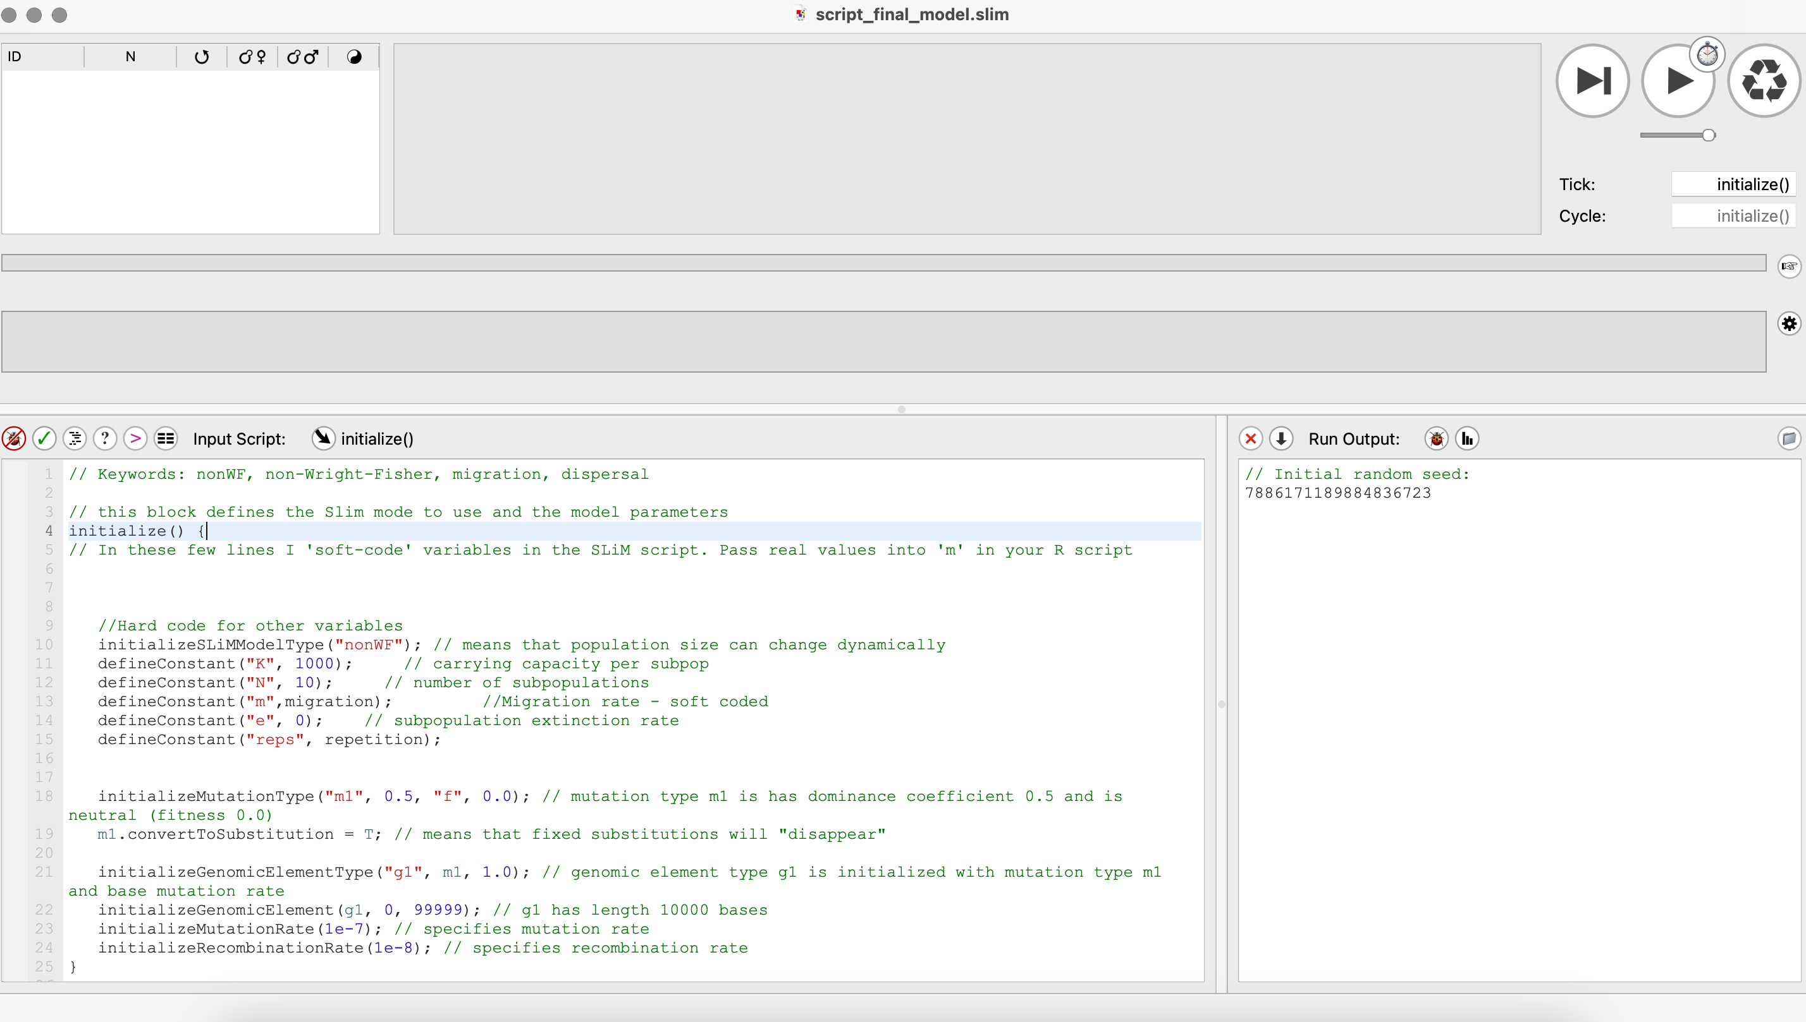
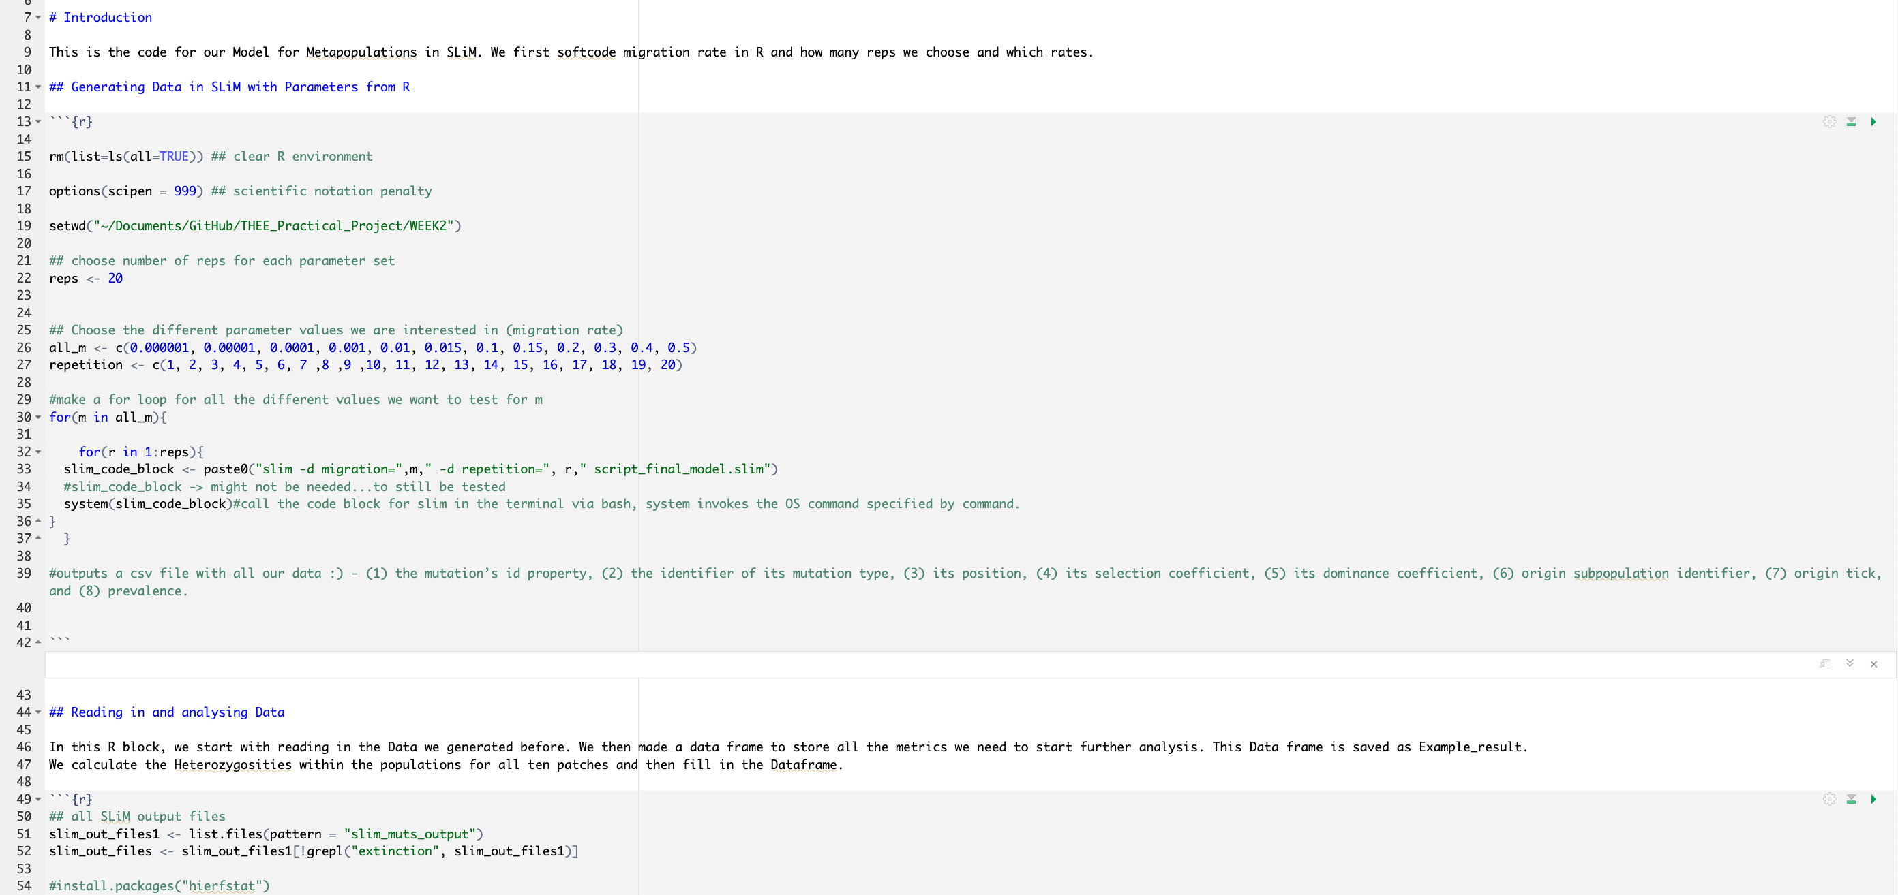
HOW? - SLiM / R - Coding
All in one R Notebook!
First softcode Parameters in R (migration rate, repetitions)
make a SLiM code block which we send to SLiM to run
Output Data we get….
Collect all the Data to analyse
Genome Wide Heterozygosity → Mean Heterozygosity
Mean of Means (1 for every Migration rate)
Plot ☺
Notes:
From the output it is visible how many individuals in a subpopulation have mutations and where in the genome. With this info we were able to calculate genome wide heterozygosity within demes (
Do not compare demes, look at the allele frequencies in each deme seperately.
Genome wide H (=2pq) => of every subpop
Mean => meaned over all 10 subpops from one run
Mean of means => mean of all the heterozygosity means of the 20 runs we did for every migration rate

Slide 5
RESULTS!

Slide 6
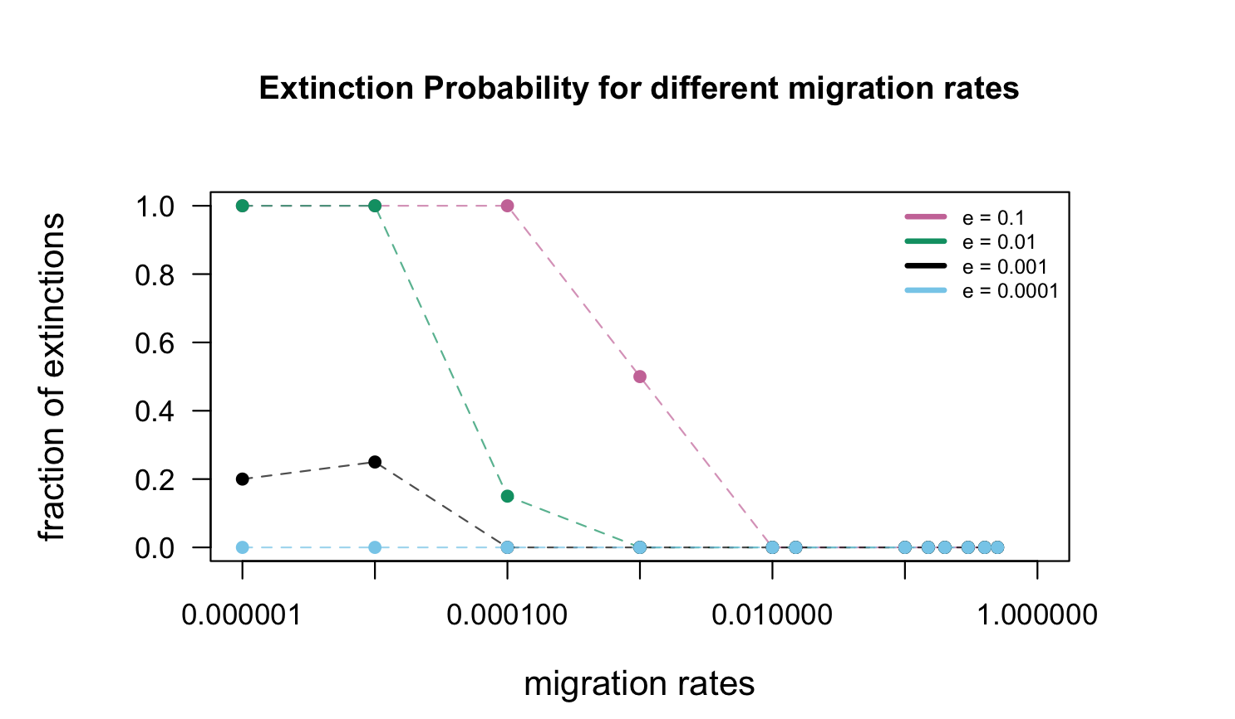

Slide 7
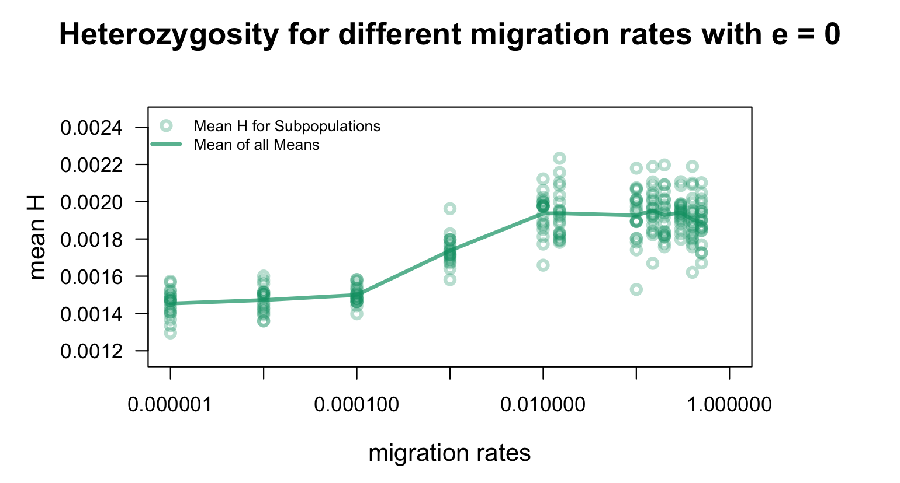
WHAT IS THE SURVIVAL IF EXTINCTION IS EQUAL TO 0?
BUT HOW ABOUT OTHER EXTINCTION RATES…?

Slide 8
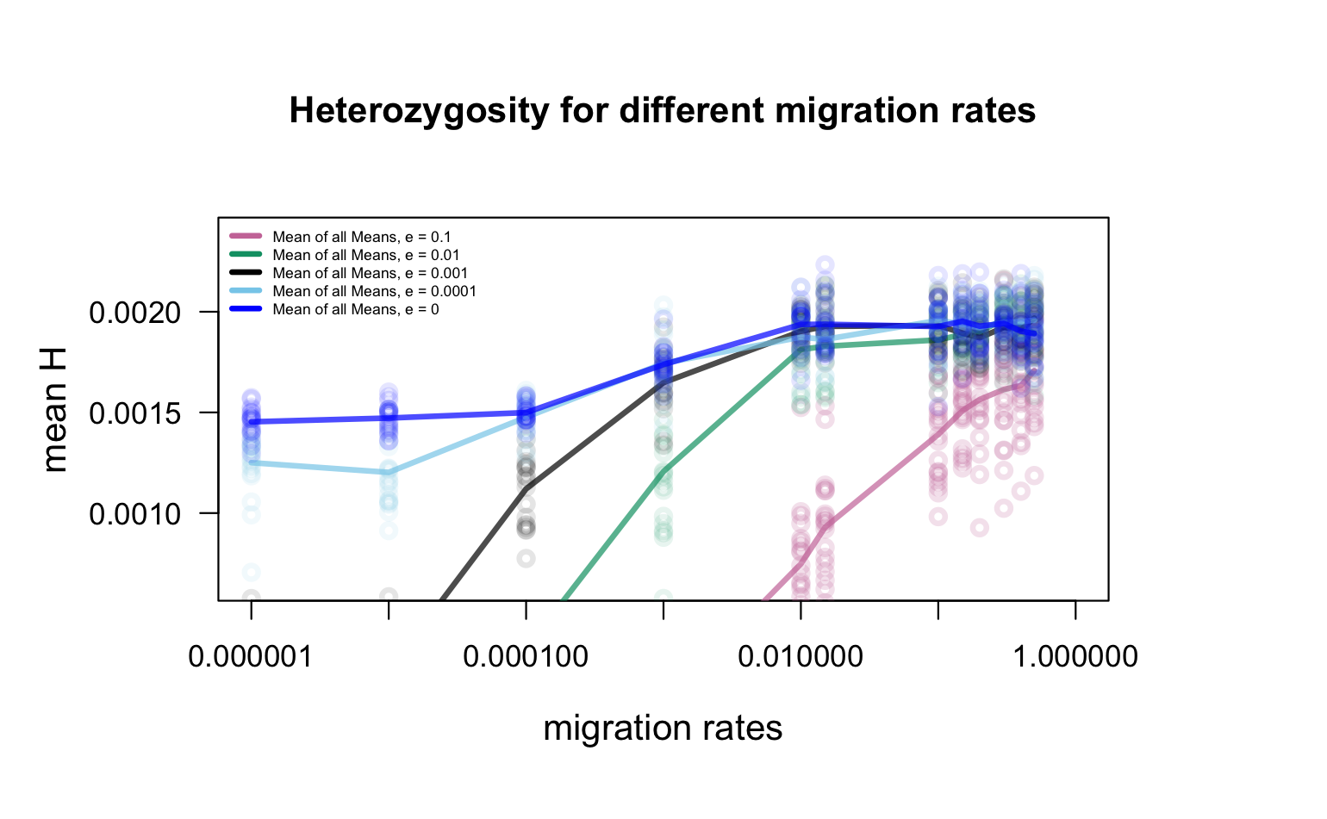

Slide 9
INTEPRETATION / DISCUSSION
Higher Migration = Higher Heterozygosities (as expected)
Not much Migration needed for Rescue
Implications for Conservation Measures
Notes:
A high amount of migration leads to genetically very diverse Subpopulations. As mentioned at the beginning, we took this as a proxy for a “healthy” and stable population. In other words, something we are looking for when doing conservation biology.
As you can see in the left plot, even with a very high extinction rate of 0.1, extinction probability is 0 if the migration rate is 0.01 (1% of individuals migrate per generation) or more.
For conservation, this shows that migration is very important, and we must make sure that it is guaranteed.
If we could choose how to build a reserve (when looking at this model), one large habitat would be best. But if this is not possible, multiple small ones would also work but there must be a certain amount of migration to prevent extinction. – you could get the migration rate needed (for a certain extinction rate) from the model, so that the population you want to conserve can persist.

Slide 10
LIMITATIONS / NEXT STEPS…
And now? Extend the Model!
Heterozygosity between Subpopulations?
Different Carrying Capacities (Size) of Subpopulations
More Extinction rates
Different Migration Rates between the Subpopulations
Different mutations (especially non neutral ones!)
And much more…..

Slide 11
OUR TAKE HOME
As expected, migration plays an important role in conserving populations (perserving genetic variation).
With higher genetic variation, the chance of extinction decreases.
We did not expect the effect to be this strong.
Notes:
We expected the effect to be visible, but not as clear as it turned out.

Slide 12
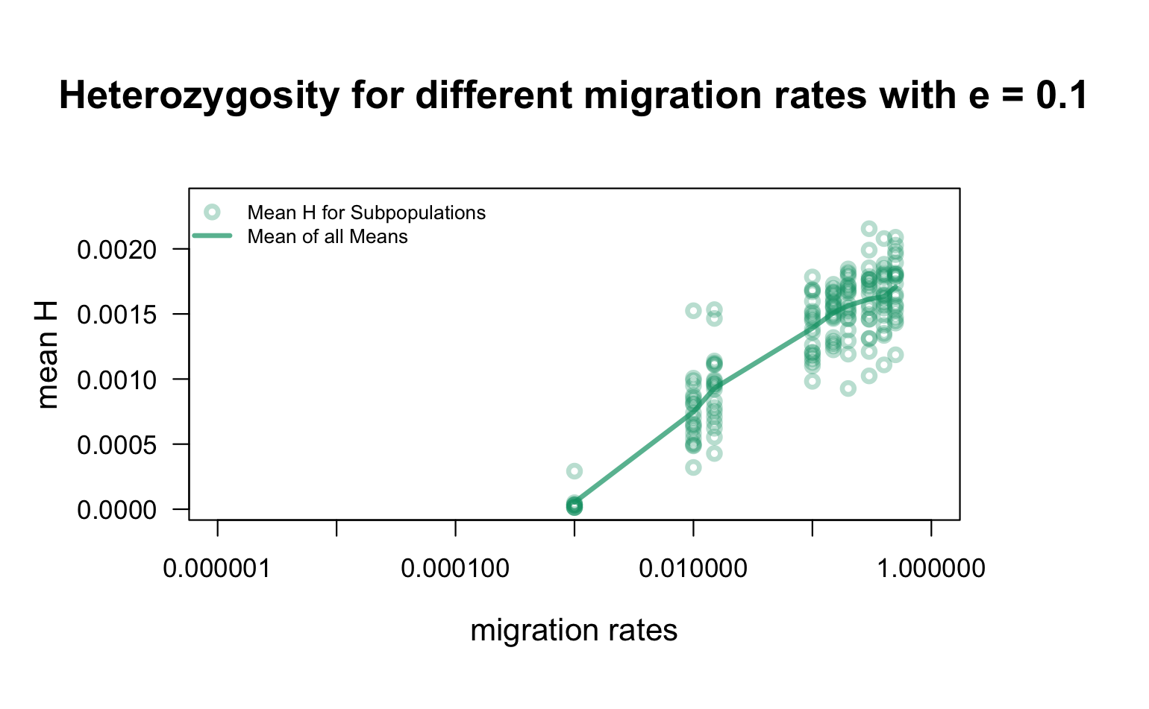

Slide 13
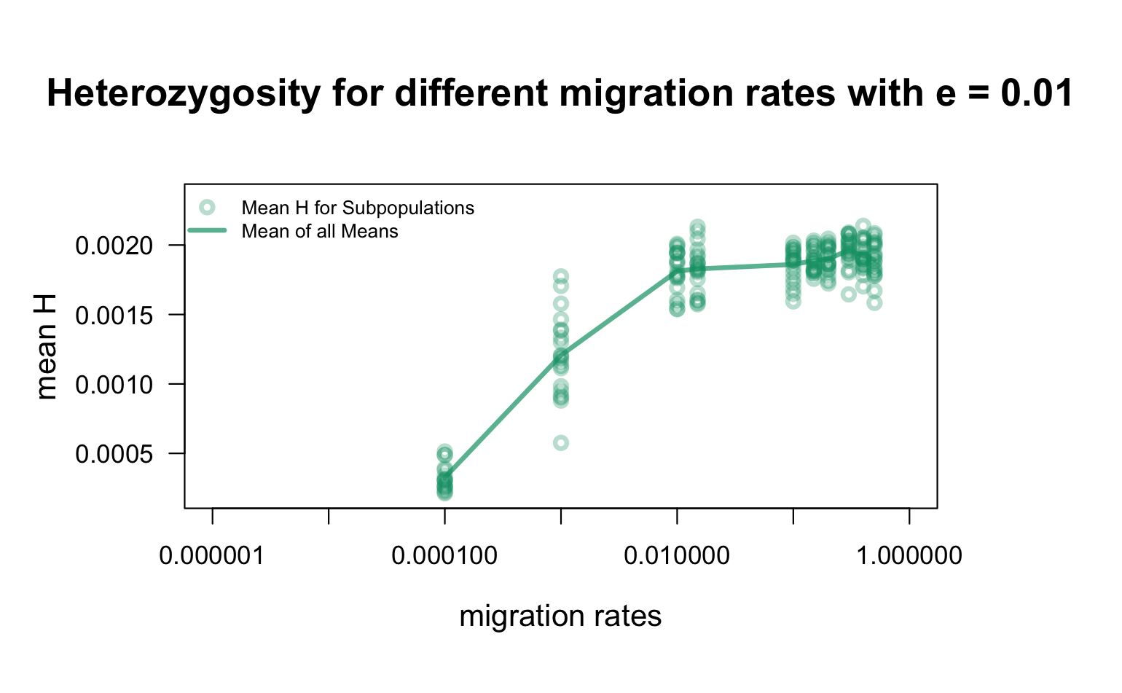

Slide 14
